Slide 1








Y11 Apps Chapter 6 VOCABULARY
A matrix that has all elements equal to zero is called a zero matrix.
A 2 x 2 zero matrix would look as follows $\left[\begin{matrix}0 & 0 \\ 0 & 0\end{matrix}\right]$ and is usually indicated with the letter O
Zero matrices in matrices have some common attributes to the number zero in the number system.
In the number system the following equations are true, with x representing a number
$$x+0=x$$
$$0+x=x$$
$$x×0=0$$
$$0×x=0$$
With A representing a matrix, the following is also true using the zero matrix
$$A+O=A$$
$$O+A=A$$
$$AO=O$$
$$OA=O$$

Slide 2
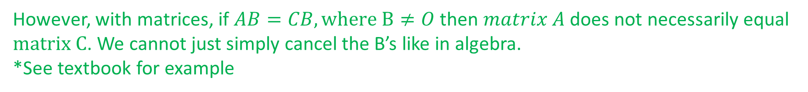
Y11 Apps Chapter 6 VOCABULARY
Although some rules for numbers also apply to matrices. We need to be careful about applying all number system rules to those of matrices.
For example, we already know that two matrices, A and B, usually have differing results when pre or post multiplied. i.e. AB=BA if at all possible.
Some other notable exceptions:
With x and y representing numbers, if $xy=0$ then either $x=0$ and/or $y=0$
However, with matrices, if $AB=O$ then it is not necessarily the case that $A=O$ and/or $B=O$
*See textbook for example
With x and y representing numbers, if $xy=zy,$ $y≠0$ then $x=z$
However, with matrices, if $AB=CB, where B≠O$ then $matrix A$ does not necessarily equal $matrix C$. We cannot just simply cancel the B’s like in algebra.
*See textbook for example

Slide 3
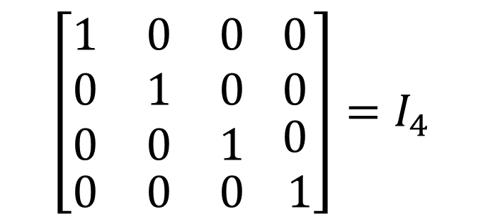
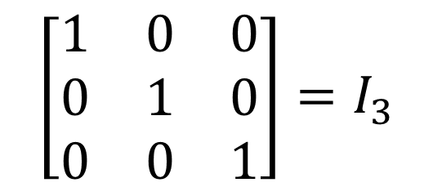
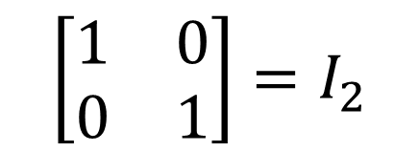
Y11 Apps Chapter 6 VOCABULARY
A zero matrix is also referred to as an additive identity matrix as when you add it to another matrix, the result is unchanged.
A multiplicative identity matrix (I) has the same result when multiplication of matrices occurs
Therefore if $I_{m×n}A_{n×p}=A_{n×p}$ it would follow that $m=n$
Thus multiplicative identity matrices are square matrices, labelled as the letter $I$
A multiplicative identity matrix has every entry of its leading diagonal equal to one and every other entry equal to zero.
$$\left[\begin{matrix}1 & 0 & 0 \\ 0 & 1 & 0 \\ 0 & 0 & 1\end{matrix}\right]=I_{3}$$
$$\left[\begin{aligned}\begin{matrix}1 & 0 & 0 \\ 0 & 1 & 0 \\ 0 & 0 & 1\end{matrix} \\ \begin{matrix}0 & 0 & 0\end{matrix}\end{aligned}\begin{matrix} 0 \\ 0 \\ \begin{matrix} 0 \\ 1\end{matrix}\end{matrix}\right]=I_{4}$$
$$\left[\begin{matrix}1 & 0 \\ 0 & 1\end{matrix}\right]=I_{2}$$

Slide 4




Y11 Apps Chapter 6 VOCABULARY
Like the zero matrix, there are some parallels with the Identity matrix and the number system. In the number system:
$$x×1=x$$
$$1×x=x$$
With A representing a matrix, the following is also true using the zero matrix
$$AI=A$$
$$IA=A$$
However, there are exceptions again:
With x and y representing numbers, if $xy=x,$ then for $x≠0$ then $y=1$
However, with matrices, if $AB=B$, $B≠O$ then A does not necessarily equal $I$
*See textbook for example

Slide 5
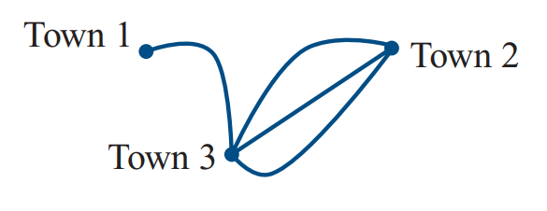

Y11 Apps Chapter 6 VOCABULARY
Route matrices show the number of direct paths from a particular Vertice to other Vertice in a network.
To
T1
T2
T3
$$\left[\begin{matrix}0 & 0 & 1 \\ 0 & 0 & 3 \\ 1 & 3 & 0\end{matrix}\right]$$
T1
From
T2
T3
Notice how all paths in the diagram are two-way so where there is a path from Town 1 to Town 3 there is also a path from Town 3 to Town 1. This will result in symmetry in the matrix along the leading diagonal. The leading diagonal has all zeros as there are no roads from Town 1 back to Town 1 directly.

Slide 6

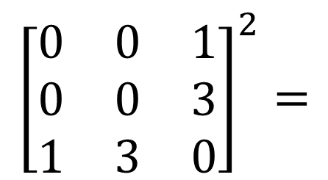
Y11 Apps Chapter 6 VOCABULARY
Now Try Ex 6C
Route matrices can also show the number of two stage paths from a particular Vertice to other Vertices in a network. As shown below:
To
T1
T2
T3
$$\left[\begin{matrix}1 & 3 & 0 \\ 3 & 9 & 0 \\ 0 & 0 & 10\end{matrix}\right]$$
T1
From
T2
T3
We can also find this by squaring the original matrix, check this on your Classpad now
$${\left[\begin{matrix}0 & 0 & 1 \\ 0 & 0 & 3 \\ 1 & 3 & 0\end{matrix}\right]}^{2}=$$

